Slide 1


ZigFi:
Harnessing Channel State Information for
Cross-Technology Communication
Xiuzhen Guo¹, Yuan He¹, Xiaolong Zheng¹, Liangcheng Yu², Omprakash Gnawali³
¹Tsinghua University
²KTH Royal Institute of Technology
³University of Houston
Notes:
Good afternoon, I’m Xiuzhen Guo from Tsinghua University
Today, I’m going to share with you our recent work “ZigFi: harnessing ['hɑrnɪs] channel state information for cross-technology communication”.
This is a CTC work from ZigBee to WiFi. In addition, this is a joint work among Tsinghua University, KTH roy al ['rɔiəl] institute of technology, and university of Houston. ['hju:stən]

Slide 2




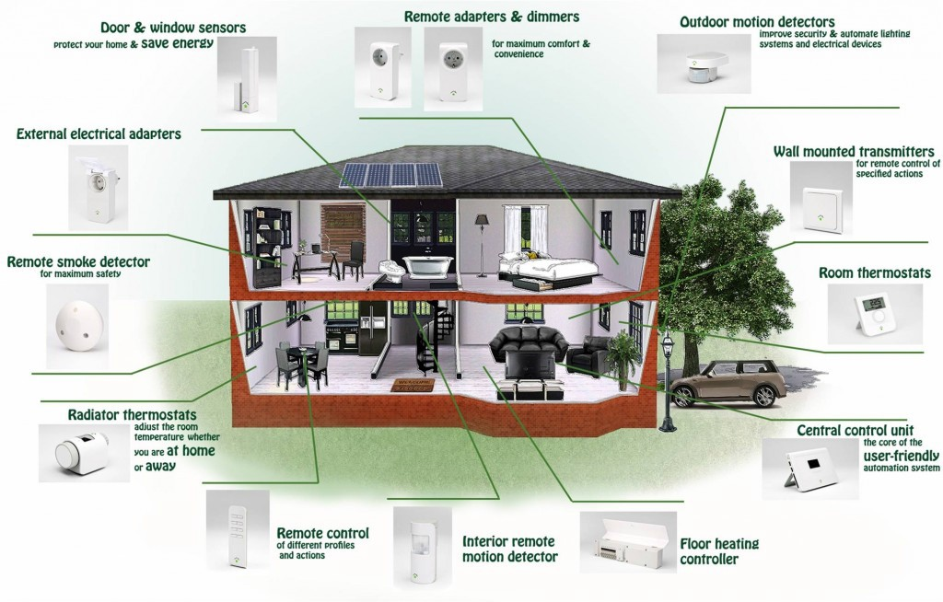
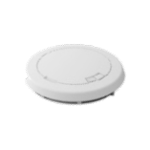

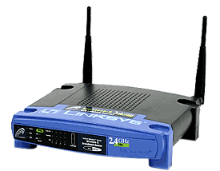

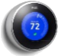









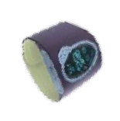

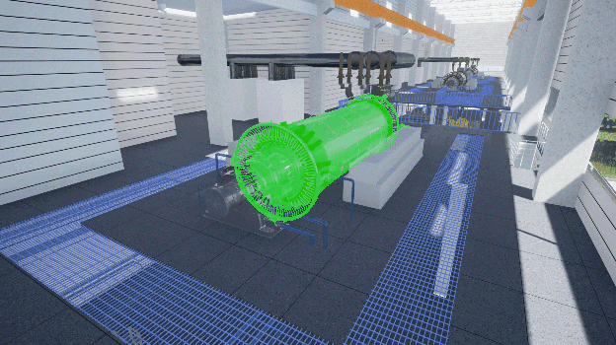



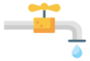
Wireless is everywhere
1.
Smart Home
Smart Hospital
Smart Factory
Notes:
As we all know, wireless signal is everywhere. Mainstream wireless technologies include WiFi, ZigBee, and Bluetooth in the ISM bands.
The proliferation [prəu-,lifə'reiʃən] of IoT applications calls for ubiquitous [ju'bɪkwɪtəs] connections among various devices. This leads to the intensive coexistence.
Under such circumstance, cross-technology communication (CTC) emerges. It can enable communication among heterogeneous devices.
With CTC, the heterogeneous wireless devices can build a new communication channel to coordinate with each other.
For example, in a smart home, the ZigBee sensors can directly report the sensory data to the WiFi device; The sensors in a smart factory can Collaborate [kə'læbəret] with each other by directly transmitting commands. In addition, CTC can also be used in portable ['pɔrtəbl] medical ['medɪk(ə)l] devices and enable smart hospital.
CTC not only provides a new way to manage wireless networks, but also enhance the ability of interoperation and data exchange.

Slide 3
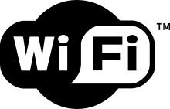
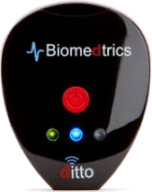
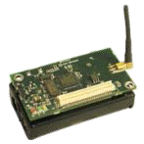
CTC among different technologies
1.
FreeBee
FreeBee
GapSense
Esense
HoWiEs
B²W²
FreeBee
WiZig
WEBee
BlueBee
Notes:
The development of CTC among different technologies is not balanced. Although there are a lot of CTC works, there is little progress in CTC from ZigBee to WiFi. The CTC from ZigBee to WiFi is essentially important for many applications. Such as the bi-communication between WiFi and ZigBee, the real-time [,rɪəl 'taɪm] data exchange, and so on.
Hence, we aim to propose a CTC form ZigBee to WiFi.
Next, we explore [ɪk'splɔr] how to achieve the CTC from ZigBee to WiFi.

Slide 4
The state of the art
1.
Packet Energy: WiZig [Infocom’17]
Packet Size: Esense [MobiCom ’09], HoWiEs [Infocom ’13]
Notes:
Nowadays, the realization of CTC mainly relies on different side channels.
First, the packet energy can be used as the side channel by controlling [kən'trol] the presence ['prɛzns] and absence ['æbsns] of WiFi packets to represent [reprɪ'zent] the CTC symbol “1” and “0”. Moreover, it increases ['ɪnkris] the number of energy levels to encode multiple ['mʌltəpl CTC symbols with a CTC window.
Second, CTC symbols can be embedded [ɪmˈbedɪd] in the packet size to convey control messages.

Slide 5
The state of the art
1.
Packet Transmission Timing: FreeBee [MobiCom ’15], Gap Sense [Infocom ’13]
Physical Signal Emulation: WEBee [MobiCom ’17],
BlueBee [SenSys ’17]
Notes:
Packet transmission timings is another side channels adopted by FreeBee and Gap sense. The key idea of FreeBee is to modulate CTC symbols by shifting the transmission timings of beacons. In addition to the beacons, Gap sense constructs customized ['kʌstəmaɪz] preambles and leverages ['lev(ə)rɪdʒ] the interval between the customized preambles to realize CTC.
It is worth noting that WEBee introduces a physical-level CTC from WiFi to ZigBee via [ˈvaɪə] payload emulation.

Slide 6
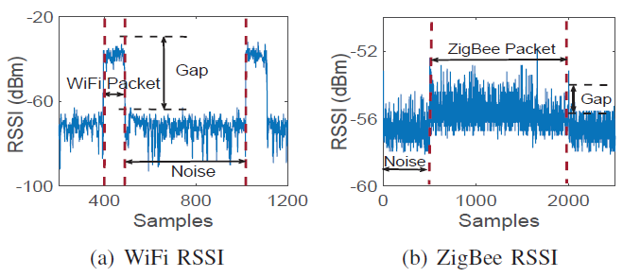
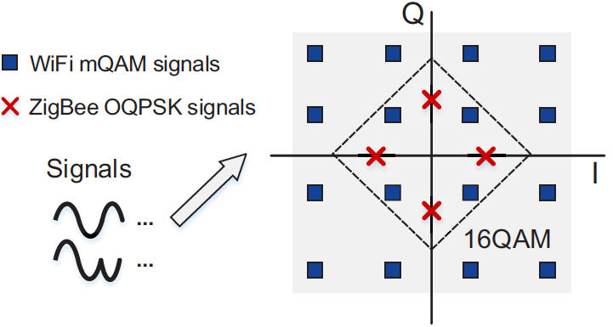
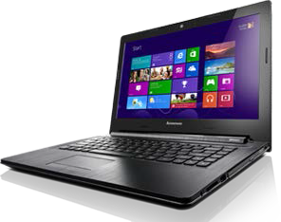
Challenges
1.
Using RSSI is inefficient
Bandwidth: 2M
Rate: 250Kbps
Modulation: OQPSK, DSSS
Tx：0dBm
Directly decoding is difficult
Bandwidth: 20M
Rate: 54Mbps
Modulation: QAM, OFDM
Tx：20dBm
Physical emulation is infeasible
Notes:
The CTC from ZigBee to WiFi is extremely challenging due to the asymmetries [ei'sɪmɪtri] between the two technologies.
First, the bandwidth['bændwɪdθ] of WiFi is ten times of the bandwidth of ZigBee and the data rate of ZigBee is much lower ['loɚ] than WiFi. Hence it is difficult to use the narrow-band ZigBee signals emulating wide-band [waɪd] WiFi signals.
Second, ZigBee adopts the modulation of OQPSK and DSSS. While [hwail] WiFi adopts the QAM modulation and leverages the method of constellation [,kɑnstə'leʃən] mapping to decode signals. Due to the phase shift of OQPSK signals and the different number of constellation points, directly decoding ZigBee signals at the WiFi receiver is infeasible
As for the transmission power, the Tx power of ZigBee is also much lower than WiFi. There is a distinctive RSSI gap for WiFi packets, whereas ['wɛr'æz], it is inefficient to detect ZigBee packets at the WiFi receiver by using RSSI.

Slide 7
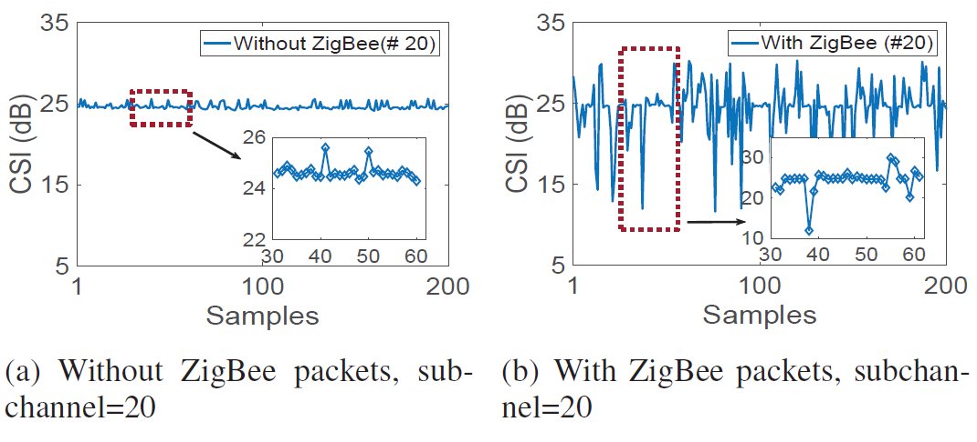
Feasibility of using CSI
1.
(Without ZigBee)
(With ZigBee)
The transmission of ZigBee packets affects the CSI significantly
Notes:
In addition to the RSSI, we explore [ɪk'splɔr] the feasibility of using CSI for CTC from ZigBee to WiFi.
The overlapping on the frequency ['frikwənsi] channel provides a theoretical [,θiə'retɪkə] support. A WiFi channel is divided into 64 different subcarriers and CSI can be used to describe the feature of each WiFi subcarrier. A ZigBee channel overlaps with several WiFi subcarriers.
CSItool can be used to collect CSI readings of WiFi subchannels.
We find that the variation of CSI sequences is distinct with and without ZigBee transmissions.

Slide 8
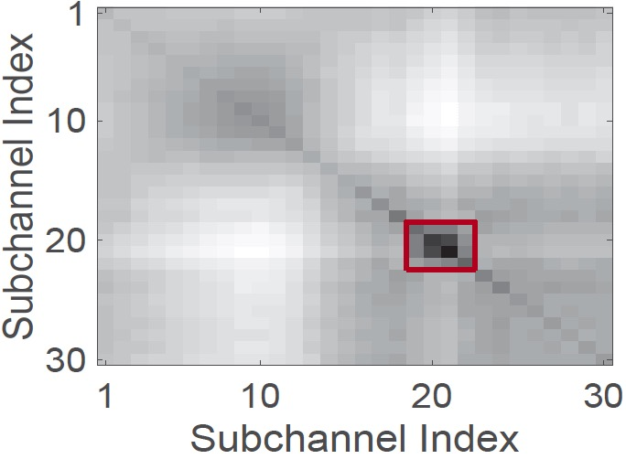
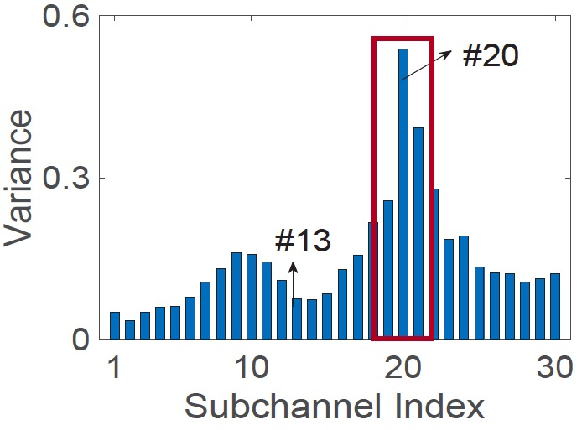
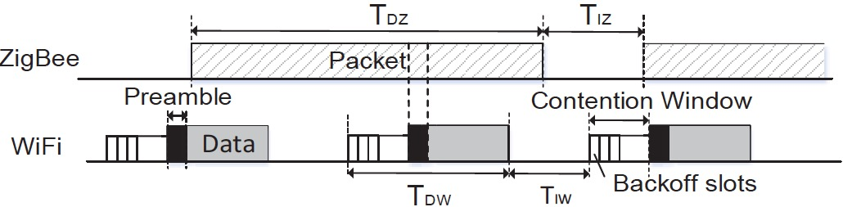
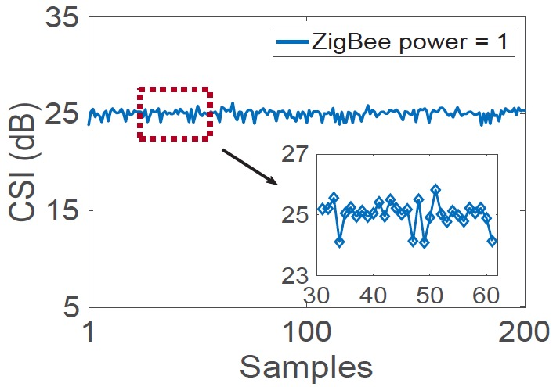
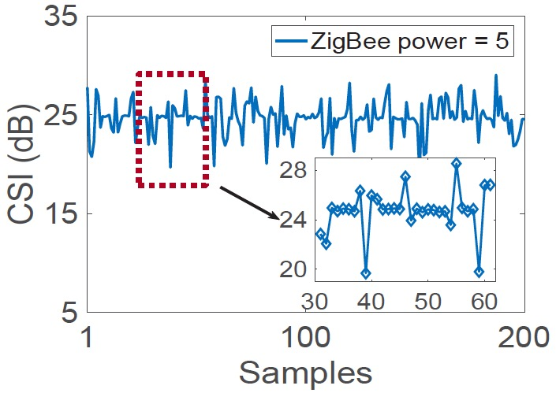
Challenges of using CSI
1.
#Subchannel
Frequency domain:
Select a proper
subchannel
#Packet Length
Time domain:
ZigBee length satisfies
a threshold
# Transmission Power
CSI sequence:
Choose an appropriate
ZigBee power
Notes:
In order to achieve CTC from ZigBee to WiFi by using CSI, several conditions need to be satisified ['sætɪsfaɪ] (没有n的音)
First, the variation of the CSI sequence on different subchannels are different. The covariance values of the overlapping channels are much larger than other subchannels. So we need to select a proper subchannel to make zigbee and wifi overlap in frequency domain
Second, the CSI is obtained by the WiFi predefined preamble. Due to the time asynchronization and asymmetry of date rate between ZigBee and WiFi, we need to transmit long enough ZigBee packets to make that one ZigBee packet overlaps with at least one WiFi packet. So the length of the ZigBee packet must satisfy a threshold.
Third, the degree of CSI variation is depend on the strength of ZigBee packets. As ZigBee transmission power increases, the CSI sequence is more distinct. Whereas, when ZigBee power is too high, the CSI sequence includes only a few peaks. This is because the WiFi sender can sense the transmission of ZigBee and back off. Hence, we need to choose an appropriate zigbee power to make csi sequence more distinctive

Slide 9
ZigFi: Harnessing CSI for CTC
1.
ZigBee packets piggy-backed to the existing WiFi link
WiFi receiver collects two sets of information
SVM classification
Notes:
So we propose ZigFi, harnessing CSI for CTC from ZigBee to WiFi
ZigFi leverages existing wifi packet transmissions to encode information from ZigBee node.
Without modifying physical layer of the WiFi or ZigBee , ZigBee packets are transmitted and piggy-backed to the existing
the WiFi link. The WiFi receiver can receive two sets of information. It decodes packets transmitted by the WiFi sender as a regular WiFi packet. It also collects the CSI sequence.
Whereas, it is difficult to quantify ['kwɑntɪfaɪ] the CSI variation because the channel is dynamic and noisy. There is no simple rules to describe the variation of CSI values. As a result, a SVM classifier is applied to identify the CSI sequence.
In this way, we translate the decoding problem into a problem of CSI classification.
The encoding and decoding steps of ZigFi are as follows. In our example, the ZigBee sender wants to send the CTC symbols ”1011” to the WiFi receiver.
First, the ZigBee sender encodes the symbol “1” as the presence of the ZigBee packet and encodes the symbol “0” as the absence of the ZigBee packet.
Second, the Zigbee sender transmits these packets or remains silent. There is an existing WiFi sender transmitting packets. ZigBee
packets overlap with WiFi packets in the air.
Third, the WiFi receiver collects the CSI sequence and uses SVM to identify whether there is an interfered CSI sequence. In this way, the WiFi receiver decodes the CTC symbol from ZigBee

Slide 10
Encoding and decoding
1.
Encoding: Presence or absence of ZigBee packets
Decoding: SVM identifies the interfered CSI sequence
Notes:
The encoding and decoding steps of ZigFi are as follows. In our example, the ZigBee sender wants to send the CTC symbols ”1011” to the WiFi receiver.
First, the ZigBee sender encodes the symbol “1” as the presence of the ZigBee packet and encodes the symbol “0” as the absence of the ZigBee packet.
Second, the Zigbee sender transmits these packets or remains silent. There is an existing WiFi sender transmitting packets. ZigBee
packets overlap with WiFi packets in the air.
Third, the WiFi receiver collects the CSI sequence and uses SVM to identify whether there is an interfered CSI sequence. In this way, the WiFi receiver decodes the CTC symbol from ZigBee

Slide 11
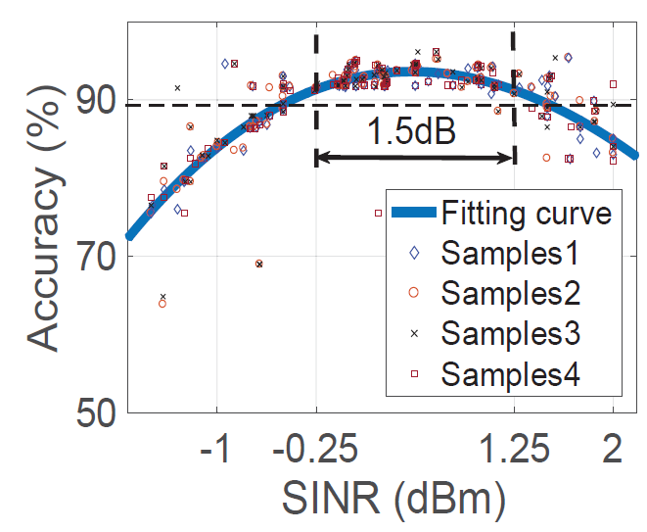

SINR in ZigFi
1.
$$SINR=10lg\frac{S_{Z}}{I_{W}+N}$$
SINR in range [-0.25,1.25], decoding accuracy > 0.9
Notes:
As the above discussed, the ZigBee transmission power
affects the degree of the CSI variation. If the ZigBee transmission
power is low, the CSI variation will be too little to be
detected at the WiFi receiver. Whereas, if the Zigbee power is
too high, the WiFi to WiFi link will be affected.
Hence, we define a new metric SINR in ZigFi. The effective signal in ZigFi is the received strength of ZigBee packets and the interference is the power of WiFi packets.
The SINR has a direct impact on the accuracy ['ækjərəsi] of decoding.
In practice, it is difficult to quantify the CSI variation due
to the channel dynamics. Thus we use an experimental [ɛk'spɛrɪ'mɛntəl]
model to describe the relationship between the SINR and the
accuracy and it can be fitted as a polynomial [,pɑlɪ'nomɪəl] curve. When the SINR is in this range, the decoding accuracy is higher than 0.9.

Slide 12
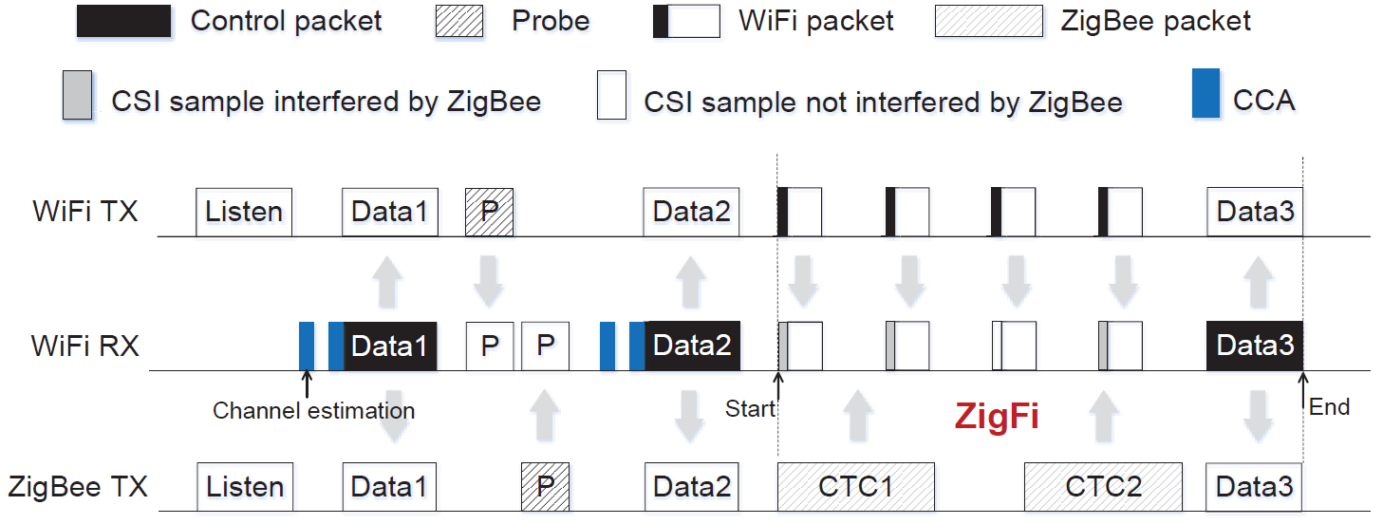
The Receiver-initiated mechanism
1.
Establish a WiFi link
Obtain an appropriate SINR
Notes:
in paractice, the transmission of ZigFi relies on existing WiFi packet transmissions, so it is necessary to initiate [ɪ'nɪʃɪet] or utilize the WiFi link. In addition, we also need to adjust the transmission power of the ZigBee sender and the WiFi sender in order to obtain [əb'ten] an appropriate SINR.
To meet the above goals, we design a receiver-initiated [ɪ'nɪʃɪetɪd] mechanism ['mɛkənɪzəm].
(1) The WiFi sender and the ZigFi sender listen to the channel. The ZigFi receiver conducts the channel estimation and detects whether there is an incoming WiFi packet. The ZigFi receiver triggers the packet transmission from both the WiFi sender and the ZigFi sender when there is no existing WiFi transmission. Then the control data Data1 is sent to the WiFi sender and the ZigFi receiver.
(2) On receiving the control packets, the WiFi sender and the
ZigFi sender send a probe to the ZigFi receiver respectively.
(3) When receiving the probes, the ZigFi receiver updates the
Parameters [pə'ræmitə] related to the channel condition and returns them
Data2 to the WiFi sender and the ZigFi sender.
(4) The ZigFi transmission starts on receiving Data2. Meanwhile, the ZigFi receiver can end the ZigFi transmission by sending the control data Data3, when needed.

Slide 13
Evaluation
1.
WiFi: Commercial WiFi device + CSITool, channel 11
ZigBee: TelosB mote, channel 23
Noise: USRP generator
Metrics: Throughput and SER
Notes:
We implement ZigFi on commercial off-the-shelf WiFi devices (Intel 5300) and TelosB motes.
The CSITool software platform is installed on the WiFi devices and used to collect CSI readings
We configure [kən'fɪɡjɚ] the WiFi channel is 11 and ZigBee channel channel is 23
we use a USRP to generate noise on demand [dɪ'mænd]
The performance [pɚ'fɔrməns] metrics we use for evaluation mainly include throughput and SER.

Slide 14
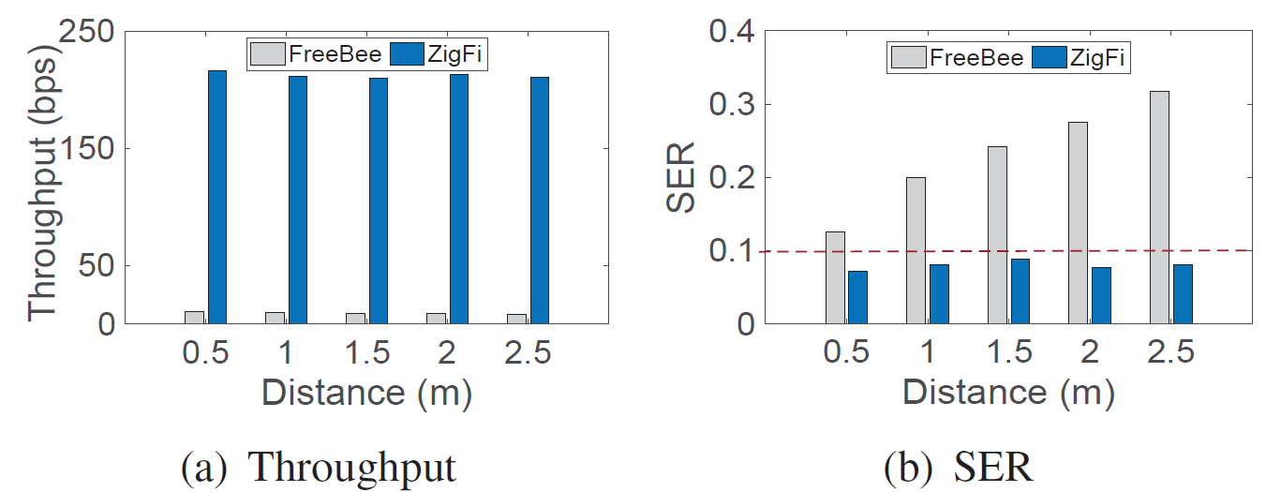
ZigFi vs. FreeBee
1.
ZigFi shows significant enhancement over FreeBee in
terms of throughput and SER.
Notes:
First, we compare ZigFi with FreeBee, a state-of-the art ZigBee to WiFi CTC work.
The parameters of FreeBee include the beacon interval
and the folding time. We set the beacon interval at 100 milliseconds ['mɪlɪsɛkənd] and the folding time at 5.
We change the distance between the ZigBee sender and the WiFi receiver.
ZigFi shows significant enhancement over FreeBee in terms of throughput and SER.
The gap in SER widens ['waidən] when the distance increases. This is because FreeBee leverages the RSSI to identify beacons. RSSI usually decreases with the increasing of distance. The SER of Freebee therefore goes up and the SER of ZigFi stays stable

Slide 15
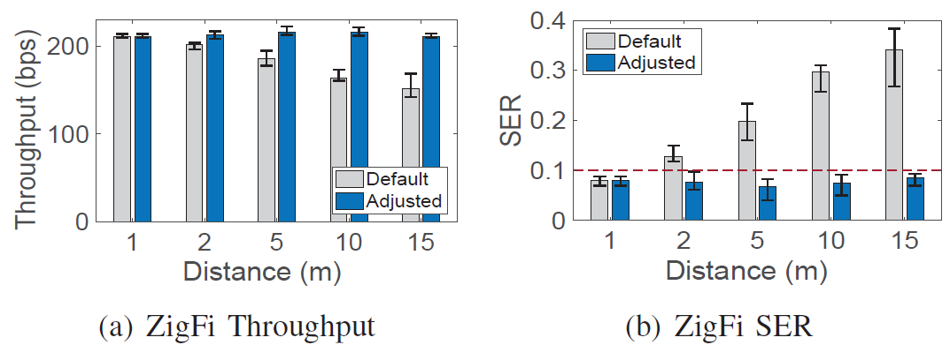
Distance
1.
The ZigBee Tx and the WiFi Rx
Adaptive is better than default.
ZigFi performs well under the adaptive mode.
Notes:
Next we study ZigFi’s performance under different settings in two different modes. The default [dɪ'fɔlt] mode doesn’t have the power adjusting module, so the ZigBee sender transmits with
a predefined minimum power. In the adaptive power mode, ZigBee sender transmits with an adaptive power, which satisfies the requirement [rɪ'kwaɪɚmənt] of SINR.
First, we evaluate ZigFi’s performance with different distance between the ZigBee sender and the WiFi receiver.
In the default mode, the SER increases and the throughput decreases with the increase of the distance. Adaptive mode is better than default mode.
In the adaptive mode, ZigFi performs well accross all distances considered [kən'sɪdɚd] under the adaptive mode.

Slide 16
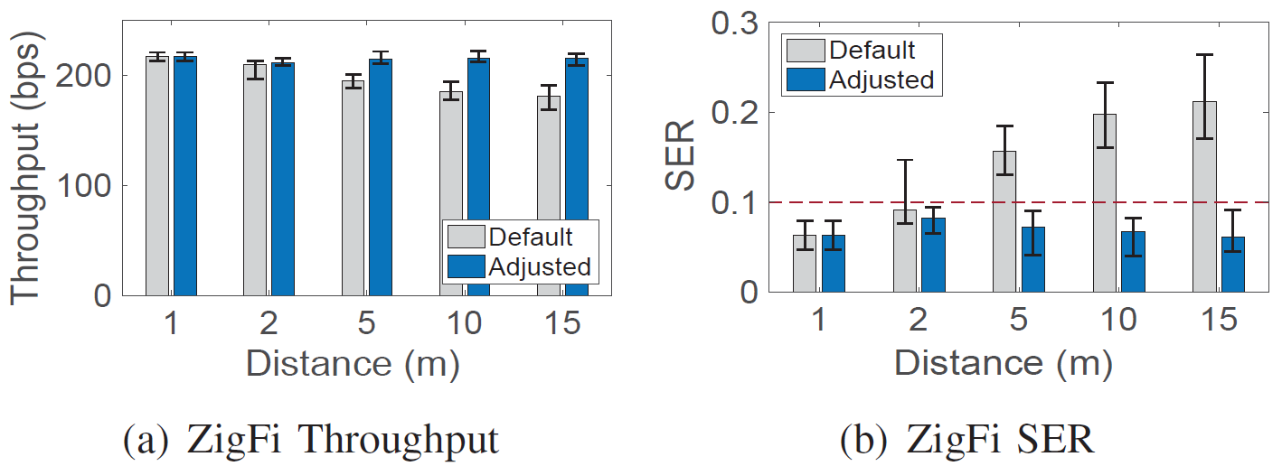
Distance
1.
WiFi Tx and the WiFi Rx
Adaptive is better than default.
ZigFi in the adaptive mode performs well.
Notes:
second, we evaluate ZigFi’s performance with different distance between the WiFi
sender and the WiFi receiver.
The distance between WiFi sender and WiFi receiver affects the WiFi signal strength at
the receiver. Correspondingly [,kɔrə'spɑndɪŋli], the ZigFi SINR will also change.
Similarly, the performance gap between the default mode and the adaptive
power mode widens when the distance increases, the performance of ZigFi is much more stable in the adaptive mode.

Slide 17
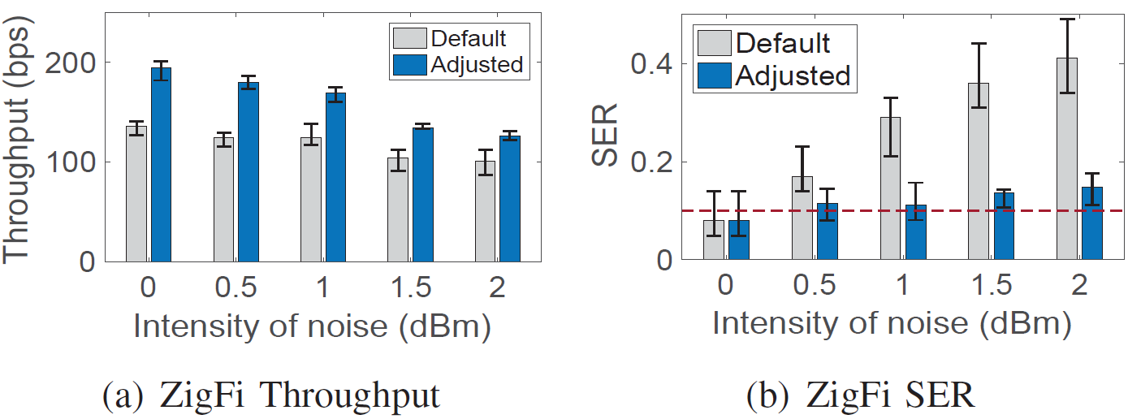
Noise
1.
Throughput of ZigFi degrades with noise intensity increases.
ZigFi in the adaptive mode is more resilient to noise.
Notes:
The performance of ZigFi under varied intensities of noise is also evaluated.
The noise in the environment is another factor that impacts the ZigFi SINR.
We can find that the throughput of ZigFi degrades when the noise intensity increases.
ZigFi in the adaptive mode is more resilient [rɪ'zɪlɪənt] to noise, with regard to the SER.

Slide 18
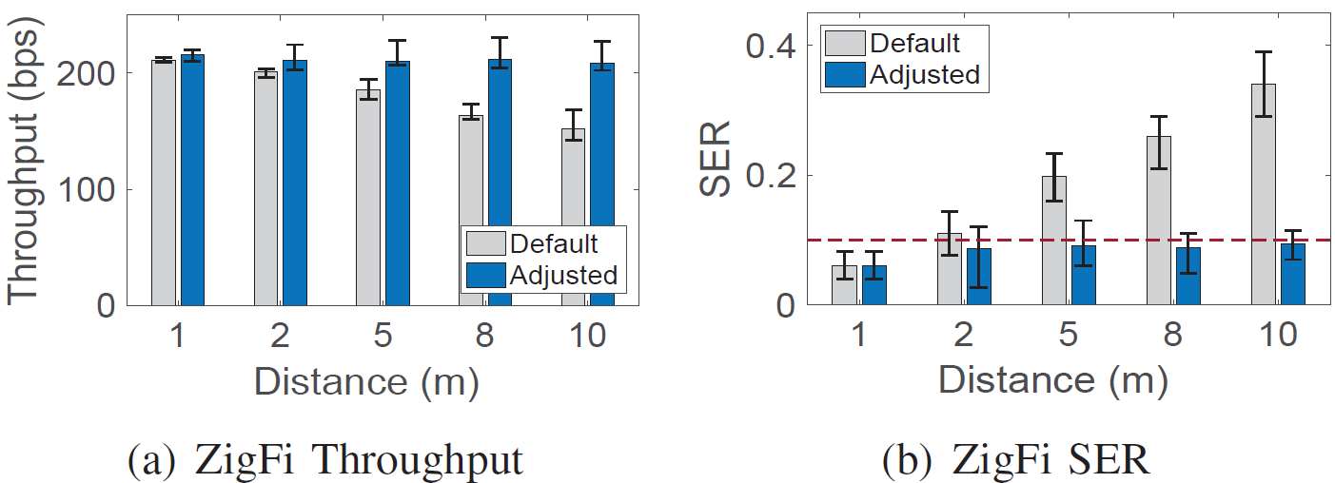
NLoS Scenario
1.
ZigFi in the adaptive mode is robust under NLoS scenario
Notes:
NLoS propagation [,prɑpə'geʃən] of signals affect the SINR of ZigFi at the receiver. In this experiment, we place an obstacle ['ɑbstəkl] between the ZigBee sender and the WiFi receiver to block the line-of-sight transmission. Then we change the distance between the ZigBee sender and the WiFi receiver
We can find that ZigFi in the default mode is susceptible [sə'sɛptəbl] to signals’ NLOS propagation. The throughput decreases and the SER increases sharply with the increase of the distances.
In comparison [kəm'pærɪs(ə)n], ZigFi in the adaptive mode is robust under similar conditions.

Slide 19
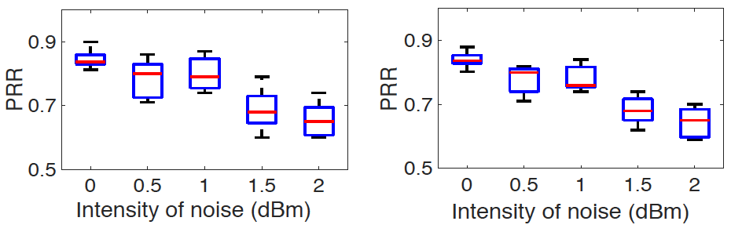
The impact on the WiFi communication
1.
(Without ZigFi)
(With ZigFi)
ZigFi has limited impact on the WiFi communication
Notes:
Communication of ZigFi requires carefully interaction between signals from ZigBee and WiFi senders and could impact WiFi performance. In the previous ['privɪəs] four groups of
experiments, we also measure the PRR of the WiFi link with/without ZigFi transmissions. Overall, ZigFi transmission has limited impact on the PRR of the WiFi link.

Slide 20
Summary
1.
We harness CSI as a side channel to achieve CTC from ZigBee to WiFi and translate the decoding problem into a CSI classification problem.
We design a receiver-initiated protocol for practical application of ZigFi.
Experimental results show that ZigFi achieves efficient and robust CTC.
Proper subchannel
Appropriate packet length
Suitable transmission power
Notes:
In conclusion, [kən'kluʒn]
First, we study how ZigBee and WiFi packets transmissions interact with each other. We find that it is feasible to use CSI to convey data from ZigBee to WiFi. Based on this finding, we
propose ZigFi and translate the decoding problem into a problem of CSI classification with SVM.
Second, we design a receiver-initiated protocol for practical ['præktɪkl] application of ZigFi. Using this protocol, a WiFi receiver can
Coordinate [ko'ɔrdɪne] the communication settings of ZigFi.
Third, we conduct several experiments to evaluate the performance of ZigFi. Experimental results show that ZigFi achieves efficient and robust [ro'bʌst] CTC from ZigBee to WiFi.

Slide 21
Q&A
Thanks
guoxz16@mails.Tsinghua.edu.cn
Notes:
Thank you so much for your attention, I’m happy to take your question

Slide 22
Backups

Slide 23
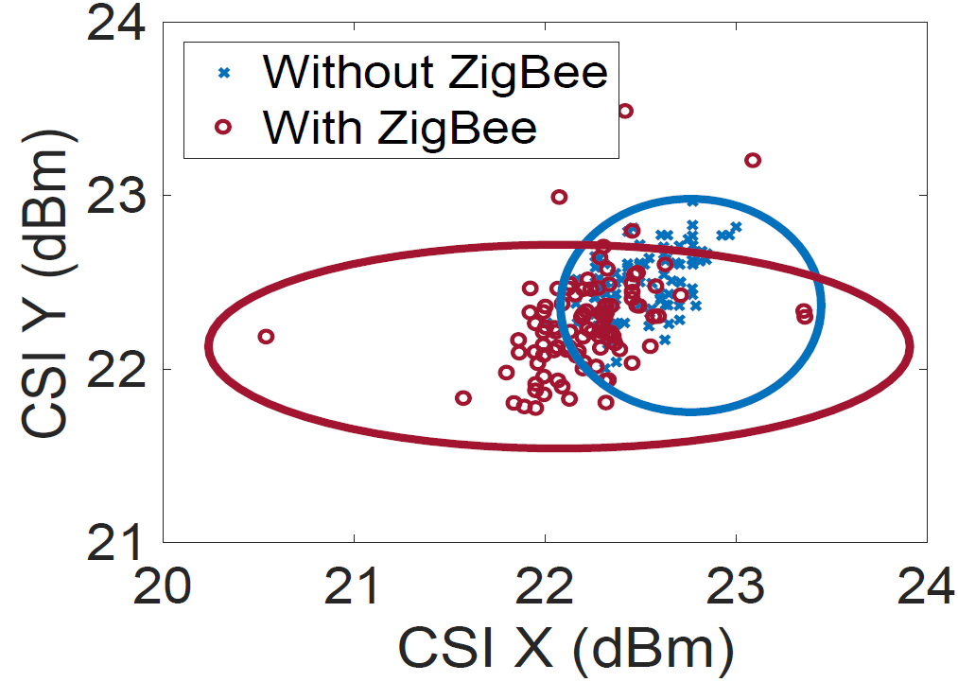
Why choose a classifier?
There are no simple rules to quantify the variation of CSI values
We need to classify these two different clusters (w/o ZigBee) at higher dimensional space
Notes:
There are no simple rules to quantify ['kwɑntɪfaɪ] the variation of CSI values because the channel is dynamic and noisy.
We define a CSI pair as a pair of CSI values, which includes two CSI values. We plot the CSI pairs obtained with and without ZigBee transmissions in two-dimension.
The two sets of CSI pair overlap with each other, making it difficult to identify the two cases with straightforward [,stret'fɔrwɚd] techniques, like threshold.
As a result, we need to classify these two different clusters at higher dimensional space. As a result, we choose a SVM classifier

Slide 24
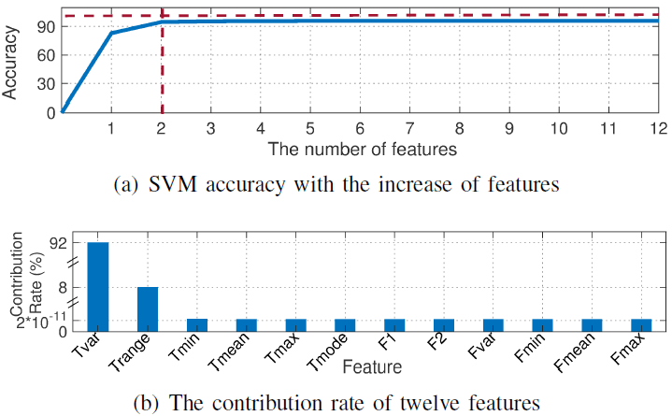
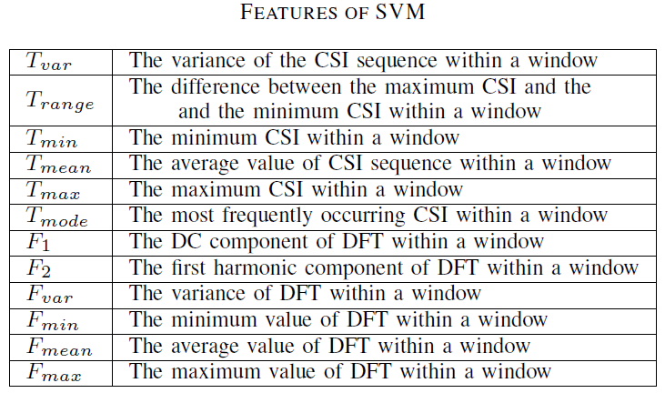
The features of SVM classifier
Two features: the variance of CSI values and the peak-to-peak value
Notes:
We extract ['ɛkstrækt] two features, one is the variance of CSI values and the other is peak-to-peak value in the time domain. These two features reveal the difference of CSI variation patterns when receiving
packet-level information from a ZigBee sender.
First, we conduct several experiments and totally choose ten features, including the maximum [ˈmæksəməm] values, mean, FFT coefficients, and so on. We find that the accuracy tends to be stable with the increase of the number of features.
We analyze the variance contribution of each feature and the contribution rate, we can find that the contribution rate of the variance of CSI values and peak-to-peak value have accumulated [ə'kjʊmjə,letɪd] over 99 percent. That means that these two features are enough for SVM classifier.

Slide 25
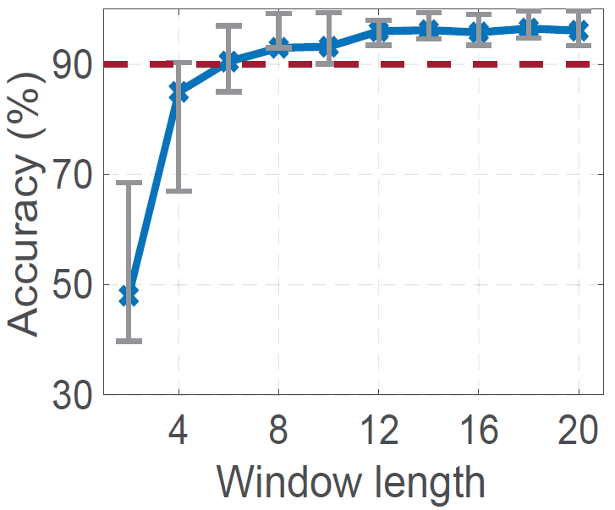
The window length of SVM classifier
A decoding window includes eight CSI values
Notes:
The accuracy of the SVM classifier also depends on the number of samples within a decoding window.
We find that the accuracy of the SVM increases rapidly as we increase the window length. After a certain point, the increase in accuracy becomes marginal ['mɑrdʒɪnl]. We suggest a window size of 8, which achieves an accuracy above ninety percent, as a good compromise ['kɑmprəmaɪz] between the classification accuracy
and the data rate.

Slide 26
Training the SVM classifier
120 experiments in four environments
A 9m*6m crowded office and a 13m*7m empty meeting room
Daytime Night
Different in terms of background noise, multipath fading, human mobility, and interference
Half “-1”and half “+1”
Notes:
We conduct 120 experiments in four environments.
We choose two different places, one is crowded office and another one is a empty meeting room. We select the CSI sequences in these two places during the daytime and the night, respectively.
In the daytime, there are twenty students in the office. These students can use WiFi to watch videos, surf the Internet, download files, and so on.
There are five students in the conference room and they are talking with each other and
only surf news site. Compared with the daytime environment, the office and the meeting room are relatively ['rɛlətɪvli] quiet ['kwaɪət] at night.
As a result, these four environments are different in terms
of background noise, multipath [‘mulpath] fading, human mobility, and
interference.
In each environment, we collect CSI sequences and label them as positive 1 or negative1. A CSI sequence with only the WiFi transmission and not overlapped with ZigBee is negative 1. A CSI sequence with the overlapped transmissions from WiFi and ZigBee is labeled positive1.
Each experiment lasts for 30 seconds and the CSI sampling rate is 2 thousands herts. The total CSI sequences
are randomly divided into training and test datasets.

Slide 27
CTC from WiFi to ZigBee
WiZig [Infocom’17]
Notes:
To send control information from the WiFi receiver to the ZigBee sender, multiple ['mʌltəpl] existing CTC techniques can be used. In our work, we select the method of WiZig.
Specifically, the payload of a WiFi packet includes data from the WiFi receiver
to the WiFi sender, while the multiple energy-levels carries the data from the WiFi receiver to the ZigBee sender.

Slide 28
Synchronization
The receiver-initiated mechanism
Continuously repeated preambles
Exhaustive search
Notes:
[,sɪnkrənaɪ'zeʃən]
[ɪɡˈzɔstɪv sɚtʃ]

